Slide 1
Robert Airth
Web-game Player Bot

Slide 2
The coolest part about my program is that I am using two threads.
I have never used explicit threading in any of the programs I’ve created before.
I was stumped trying to figure out how to easily kill my bot by pressing the ESC key since the bot takes control of the mouse movement and clicking.
I found that the only suitable solution was to run two threads – one thread running the bot script and another thread listening for keystrokes to handle (such as ESC to escape).
Here is how easy it is for me to kill my script:

Slide 3
The coolest part about my program is that I am using two threads.

Slide 4
The code I am most proud of is my code to enable Flash in Chrome
At first, I didn’t think it would be very challenging to enable flash in the Chrome browser. I tried looking up ways of a Selenium WebDriver open a Chrome browser with arguments specifying Flash to be enabled, but none of the code or solutions seemed to be working for me.
So, I figured I would manually enable Flash using the Selenium WebDriver through the Chrome settings menu. Although it seems to be a clunky kluge, this ended up being a fine solution to my problem. Unfortunately, I believe this code could easily be broken by a Chrome update.
I am most proud of this code because it required a ton of patience. The enable-Flash HTML element within the Chrome settings page was nested within several shadow-roots. I had no idea shadow roots were even a thing until my debugging revealed that I was having program-logic issues. Getting past this seemingly simple task after many hours of confusion and research made this my favorite bit of code.
Here is the enable_flash.py code:

Slide 5
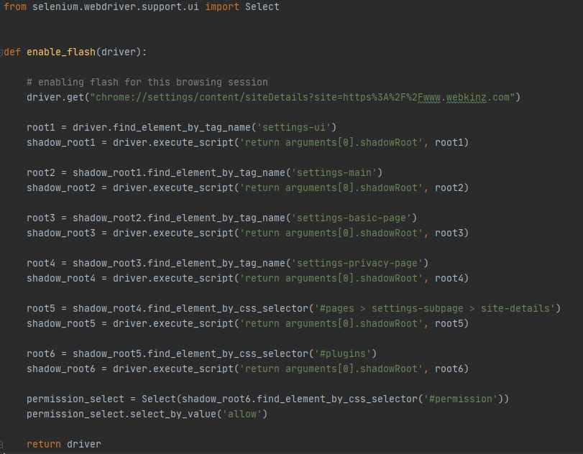
The code I am most proud of is my code to enable Flash in Chrome

Slide 6
enable_flash.py demonstration

Slide 7
If I could do it all over again, I would…
Overall, I was able to make it better than I thought. If I were to change anything, I would like to focus more on creating dynamic/AI-type solutions to the game-state sensing. Right now, I am using rudimentary image recognition over small portions of the screen to determine game-state, but I would like a more machine-learning based approach. Otherwise, I can’t think of anything I’d like to do all over again.
I am currently working on creating executable files from this code

Slide 8
The thing that I learned the most was…
I learned that I am encountering less hurdles in programming and the issues am having tend to be issues I haven’t seen before. I feel like programming is becoming a bit more intuitive/easy to understand the more I do it. Luckily, I have not been repeating my past issues/mistakes. This assignment gave me insight into:
rudimentary image recognition
input device listening and control
multi-threading
automating interactions with web pages/applications.

Slide 9
Things I’m glad I did differently for this assignment…
My past programming projects have not been very well thought through and many of them could have benefitted from Object Oriented Programming practices, but I shied away from OOP due to being unfamiliar.
This project, I made sure to approach it from an OOP perspective.
I am especially happy with how the code is structured since it is in OOP style.

Slide 10
Web-game Player Bot Demonstration

